Slide 1
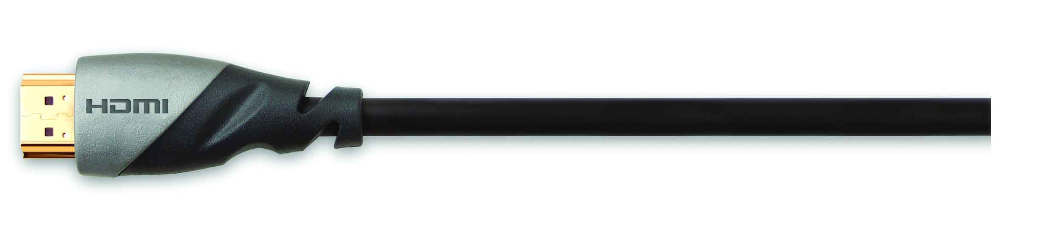

HDMI Retail Training Program
Part 1: Overview
HDMI – The Standard for Connecting HDTV
Presented by
HDMI, L.L.C.
May 27, 2004

Slide 2
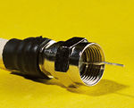
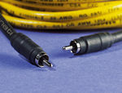
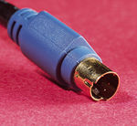

Impetus For A Digital Interface
Digital Media Permeates Our Lives
  Digital TV – cable, satellite, and terrestrial broadcasts
  Digital movies – DVDs
  Digital displays – Plasma, LCD, DLP, LCOS
  Digital interactivity – PVRs, MHP, OCAP
…But Devices Still Have Analog Interfaces
?
RF
Composite
S-Video
Component
Digital
1950 1960 1970 1980 1990 2000

Slide 3
Benefits of a Digital Interface
Transition to all digital content
  VHS being supplanted by DVD with HD-DVD imminent
  Penetration of DBS over 20%; digital cable approaching 40%
  Digital interfaces provide highest quality source to display transfer
Larger DTV screens with higher resolution
  Market sweet spot is 35-36 inch TVs & growing
  Larger screens show off superior HD quality
  Digital interfaces preserve the original quality at the display
Reduce complexity of home theater wiring
  To improve analog audio & video quality, 11 cables are used
  Digital interfaces can use a single cable for high quality A/V
Need for content protection to reduce piracy
  Difficult to adequately protect analog interfaces
  Digital interfaces can encrypt data for superior content protection

Slide 4
Introducing …
The new standard for connecting HDTV that provides:
        High Definition Video, plus
        Digital Audio

Slide 5

HDMI – High-Definition Multimedia Interface
The first and only digital interface for Consumer Electronics that can carry:
  Uncompressed high-definition video
  Compressed or uncompressed multi-channel audio
  Intelligent format & command data

Slide 6
Primary Consumer Benefits of HDMI
100% Digital
  No Compression, no conversion
  Pure digital picture and sound direct from the source
  (as it was meant to be seen and heard)
Only one cable required
  All your HD video and audio in one cable
  Replace up to 8 audio and 5 video cables

Slide 7
100% Pure Digital
Video and Audio signal remains digital from output device to display device
Best quality sound and picture
Bandwidth to spare for HDTV
  1080p capable and beyond
  Over two times 1080i bandwidth
Includes YUV color space support

Slide 8
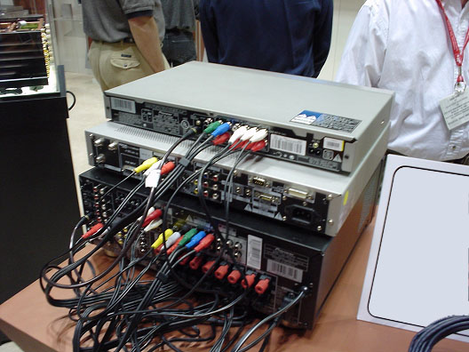
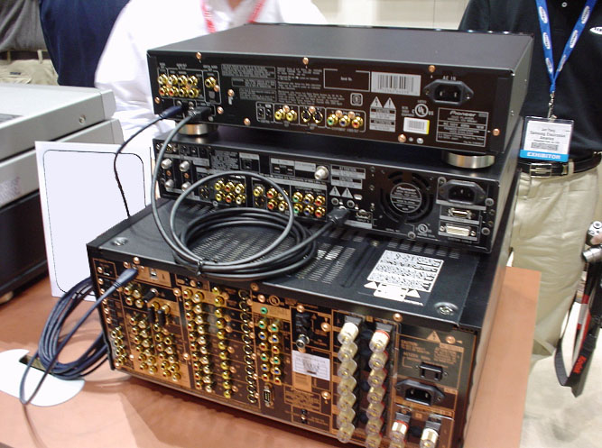
One Cable Replaces Many
BEFORE
DVD Player, Set-top box, &
AV Receiver
AFTER
Equivalent functions
Higher performance

Slide 9
Additional Consumer Benefits
Advanced Control*
  Entire home theater controlled from a single remote
Automatic Format Adjustment*
  TV & AV Receivers can adjust without consumer intervention
PC Compatibility
  Devices can playback & display PC media
* Note: Availability of these HDMI features depends on whether the manufacturer has implemented them.

Slide 10

Automatic Format Intelligence
Video source receives the display’s supported video formats, and outputs the optimal audio & video format
Display regularly receives video format & aspect ratio from sources
DVD : Widescreen Format
16:9 Display w/ no Intelligence
16:9 Display with Intelligence

Slide 11
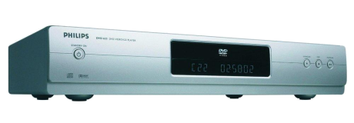
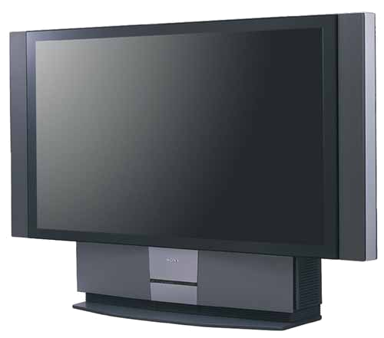
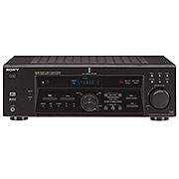
Consumer Electronics Control
Allows user to control all HDMI devices with TV remote
  Can control DVD player by pointing remote at the TV
Enables high-level functions such as “one-touch play” :
Press Play on DVD
Automatically…
Turns on TV
And then…
Plays DVD
Automatically…
Turns on A/V Rcvr
Automatically…
Switches to correct input
(from A/V Receiver)
Automatically…
Switches to correct input
(from DVD player)

Slide 12











The History of HDMI
Developed by HDMI Founders
Meets needs of CE market & enables convergence
Has broad support from Content Providers
And from Cable and Satellite operators

Slide 13









The CE Industry Has Endorsed HDMI As The HD Connection Standard
Over 100 adopters of HDMI so far

Slide 14
Feature Comparison
 | Component Video | DVI-HDCP | HDMI-HDCP
Cables
Number | 5 – 11 | 3 – 9 | 1
Length | 3 – 5 m | 10 – 15 m | 10 – 15+ m
Digital Video
8-bit RGB |  | ✓ | ✓
8-bit YUV |  |  | ✓
10/12-bit YUV |  |  | ✓
Digital Audio
Compressed |  |  | ✓
Uncompressed |  |  | ✓
Control
CE Control |  |  | ✓
PC Compatibility
DVI Electrical |  | ✓ | ✓
Content Protection
HDCP |  | ✓ | ✓

Slide 15
HDMI – The HD Connection Standard
All Digital. Single Cable.

